Slide 1
roma identity through the ages
Dr. Raul Cârstocea
Maynooth University, Ireland
ERIAC Barvalipe Academy
raul.carstocea@mu.ie

Slide 2
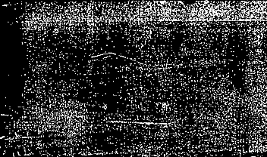

Summary
1. Identity
2. Who are the Roma?
3. A history of the Roma in Europe
4. Anti-Roma racism, eugenics, escalation of persecution
5. The Roma Holocaust
6. Postwar and the establishment of Roma identity
7. Where are we now and why does Roma history matter?

Slide 3
Identity
Individual vs. collective; here, we are concerned with collective identity
Ethnicity, race, nationality, language, religion, gender, sexual orientation, class, caste, occupation, etc.
Multiple identities, flexible, and situational
Importantly, both self-identification and external ascription
Ethnic identity: primordialism / essentialism vs. constructivism / instrumentalism
Primordialism: sees ethnic identities as fixed and unchanging, rooted in the distant past; belief in common descent or (at least) common culture
Constructivism: sees ethnic groups as social constructs, based on shared beliefs in belonging to a community; related to power and status

Slide 4
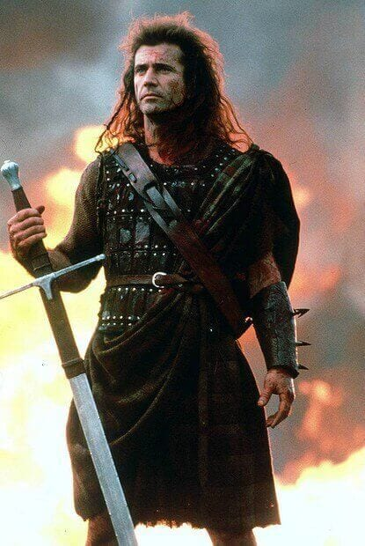

What do historians think?
‘Identity’ is a modern concept, and ethnic / national identity was ‘invented’ in the 18th-19th centuries
Example of kilts as Scottish national symbols – not worn until the 17th century (at the earliest), possibly invented by an Englishman, yet seen as ‘timeless’ traditional clothing
National indifference the norm in pre-modern times; local, religious identities
Eugen Weber, Peasants into Frenchmen: states created national identities, and this was a difficult process involving massive institutional investment (e.g. compulsory education) and coercion
What about groups that did not have their own state, like the Roma or Jews?
Mel Gibson as ‘Braveheart’ William Wallace (1270-1305) wearing a kilt at the Battle of Stirling Bridge, September 1297

Slide 5

Who are the Roma?
A European nation with roots in India (linguistically still visible)
Term (meaning ‘people’ in Romani language) introduced during the first World Roma Congress in 1971
Umbrella term covering more than 40 different groups, with different names, including some that self-identify only as ‘Roma’: Arlije, Calé, Gurbet, Kaale, Kalderaš, Lovara, Manuš, Sepečides, Sinti, Ursari, etc.
The term ‘Gypsy’ more frequently used throughout history: racial slur, mistaken association of Roma with Egyptians; its use is rejected by almost all Roma organisations today
It was often used in relation to nomadic, itinerant people more generally, so in historical documents it is often not clear if the people it refers to are actually ethnic Roma

Slide 6
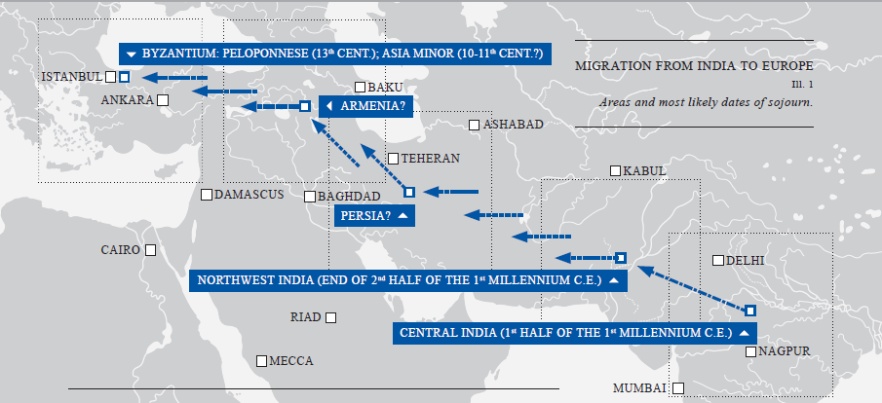
Arrival in Europe
Very limited historical evidence: left northern India sometime in 5th-10th century CE → Byzantine Empire: in present-day Greece by 13th century

Slide 7
A European minority
Evidence of the presence of Roma in Europe (13th-14th centuries): the Ottoman Empire, Central Europe, Western Europe
Initially tolerated, yet mostly marginalised community
Unclear if historical references to ‘gypsies’ refer to Roma or other nomadic groups
‘Identity’ mostly local at this time, but some evidence that Roma lived separate lives from majority societies
Increasing association with criminality and deviance
The Roma specialised in certain trades, including performing music and (pictured here) puppet shows

Slide 8
Slavery in the Romanian principalities
Wallachia and Moldova: different from the rest of Europe in that Roma were subject to slavery for 500 years
First mention of their presence in Wallachia (1385) evidence of slavery: donation of 40 Roma (‘Gypsy’) families to a monastery by Voivode Dan I
Three categories: owned by the state (‘Crown slaves’), the church, private individuals; both nomadic and settled
Abolitionist movement in the 19th century: state (1843), church (1847), private (1856) slaves freed
Bill of sale for a group of Roma slaves, 1558

Slide 9
Persecution
Associated with the development of modern states across Europe
Policies of forced settlement, anti-”Gypsy” laws, and expulsions
“Gypsy hunts” in Saxony and Habsburg Empire as population offered rewards for catching Roma
Corporal punishment (whipping, torture, branding), even execution without trial considered lawful for Roma; sterilisation of women; children put in poorhouses
Forced assimilation in Spain and Portugal: partial failure leading to the Great “Gypsy” Round-up of 30 July 1749: 10,000-12,000 Roma interned
Warning sign at the borders of the Holy Roman Empire warning Roma not to enter
(c. 1715)

Slide 10
Jews and Roma: parallel histories?
The main targets of racism in Europe during and after the 19th century. Why?
Middlemen, ‘service nomads’ (Yuri Slezkine, The Jewish Century): performed the functions that the majority populations were unable or unwilling to perform, due to religious prohibitions, stigma, etc.: from tradesmen, inn keepers, money-lenders (Jews) to fortune-tellers, executioners, gravediggers (Roma)
Separate communities, with distinct languages and customs: alien & rootless; more abstract notions of ‘crossing boundaries’ (of proper behaviour) → modern nation-states seeking to homogenise their populations see them as racial others
‘Scientific’ racism and eugenics (idea that populations can be improved through selective breeding) targeting both groups; in the case of the Roma, scientifically inaccurate eugenic ideas about the genetic propensity to crime of certain individuals important for understanding their marginalisation and persecution in the 20th century, including in Nazi Germany, but also in other countries

Slide 11
Yet different
Jews: perhaps the most literate group in Europe; Roma: very high rates of illiteracy (the norm for majority of the population until the 20th century) → problem of (lack of) sources written by Roma
Divergent lives: Jews living predominantly in urban centres, Roma in urban peripheries and rural areas
Occupations of Jews, marginal in pre-modern Europe when land ownership (which was prohibited to them) was the mark of wealth and prestige, become the most lucrative in capitalism: trade and finance → very quick upward mobility, business elites in 19th century Europe
Roma: extreme poverty, bottom of the social hierarchy, whereas Jews were feared to be occupying the top → strident political antisemitism vs. silent persecution (no similar anti-Roma rhetoric despite violence)

Slide 12
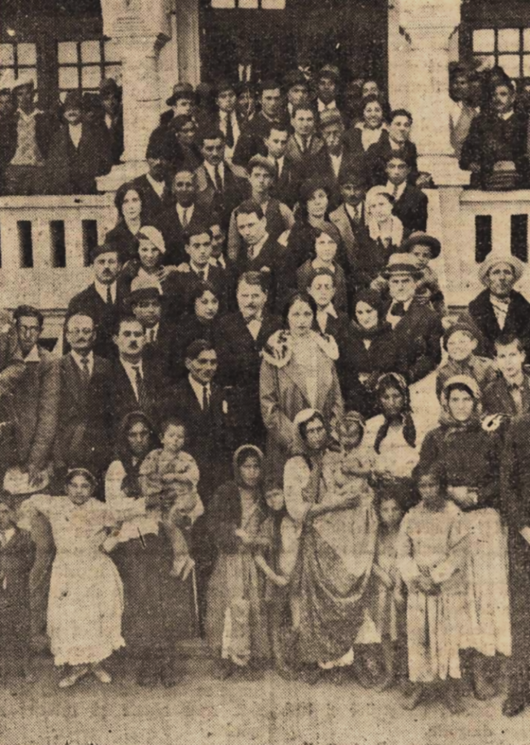
The beginnings of Roma politics
Visibility of typically invisible Roma during the campaign for the abolition of slavery in the Romanian principalities (mid-19th cent.)
Attempts at establishing Roma institutions / forms of Roma representation since late 19th century (Habsburg Empire)
Intensified after WWI: Bulgaria, Romania
Attempts at full recognition / integration in the Soviet Union: Roma Komsomol (1923), ‘All-Russian Union of Gypsies’ (1925), “Gypsy” kolkhozes & artisan cooperatives, education, language & literature, Romen Theatre in Moscow (1931)
Gheorghe A. Lăzăreanu-Lăzurică, founder of General Union of Roma in Romania (1933); opposition to the term “Gypsies” (although earlier organization called ‘General Union of Romanian Gypsies’)
First meeting of the General Union of the Roma in Romania, 8 October 1933

Slide 13
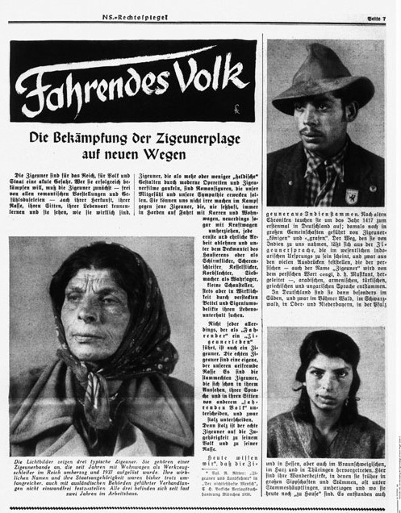
The Roma in Nazi Germany
The only other group besides the Jews targeted on racial grounds; the second largest victim group in the Holocaust (500,000 victims)
20,000-30,000 Sinti and Roma in Germany in 1933, compared to 500,000 Jews
Targets of the infamous 1935 Nuremberg Laws – loss of citizenship
In the lead-up to the 1936 Berlin Olympics, 600 Roma were arrested and taken to Marzahn, an open field next to a sewage dump, later made into a concentration camp
1937: deportations of Roma to the Buchenwald concentration camp, followed in 1938 by further deportations to Dachau, Sachsenhausen, Ravensbrück + Mauthausen (after the annexation of Austria)
The deportation of Roma as ‘asocials’ and ‘work-shy’ antedated the mass deportations of Jews following Kristallnacht
“Travelling people. New ways to combat the Gypsy plague”, Legal Office of the Nazi Party, February 1939

Slide 14
Mass murder
Mass executions of Roma began after the invasion of the Soviet Union in June 1941; at least 100,000 Roma killed outside of the camp system in territories under the control of Nazis and their allies
Labour camps, internment in ghettos (e.g., the Łódź Ghetto), concentration and extermination camps
December 1942: decree by Heinrich Himmler that all Roma remaining in the Reich are to be deported to Auschwitz
Medical experiments undertaken by Joseph Mengele on Roma; forced sterilisation of Roma women without anaesthesia
The “Gypsy family camp” had the highest mortality rate of all the Auschwitz camps: approx. 20,000 out of 23,000 Roma died there, from hunger, epidemics, and gassed
“The Cry. My brother Ossi Z-5743 in Birkenau
1943 died from hunger and typhus
fever”. Painting by Karl Stojka.

Slide 15
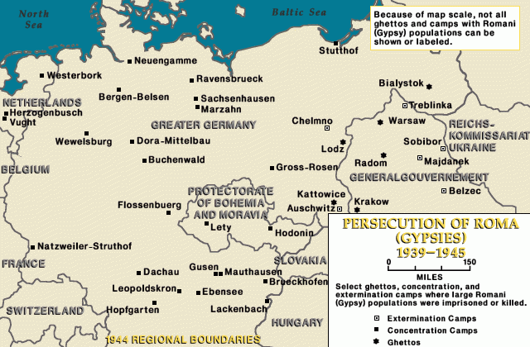
The Roma Holocaust: sites of persecution and mass murder
United States Holocaust Memorial Museum,
‘Genocide of European Roma 1939-1945’, Holocaust Encyclopedia

Slide 16
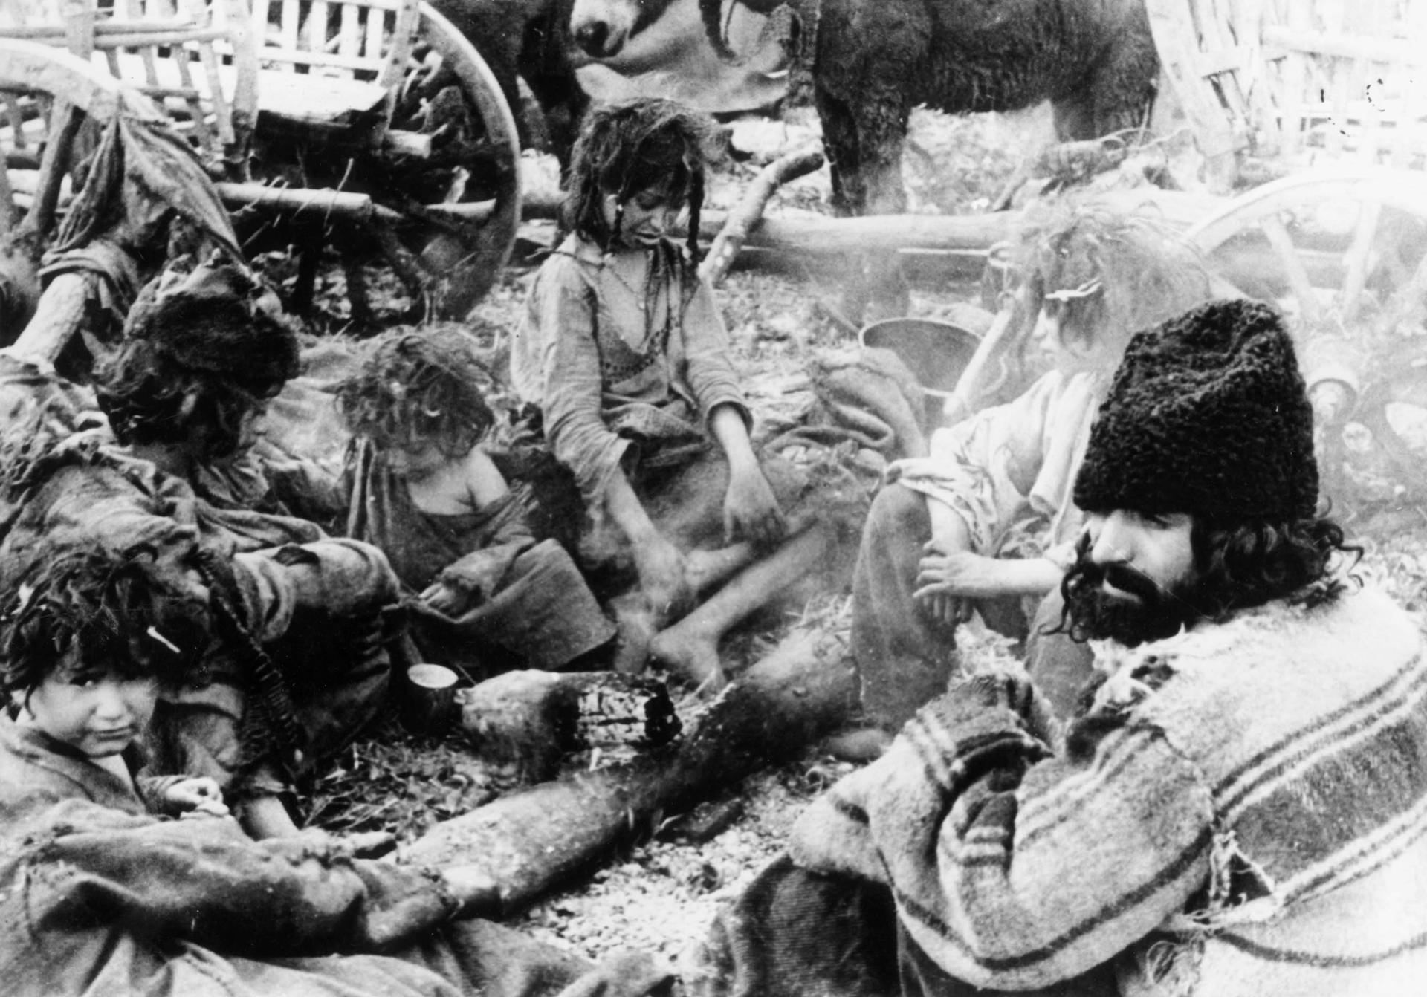
Hitler’s allies
Persecution and mass murder of the Roma carried out independently of Nazi Germany by the governments of Croatia and Romania
Croatia: at least 25,000 Roma, virtually the entire Roma population in the country, killed in the concentration camp system set up by the Ustaša, the Croatian fascist movement, especially at Jasenovac, the largest of them. In all of Yugoslavia, approx. 90,000 Roma victims. Harald Turner, head of the German military administration in Belgrade, reported to Berlin in August 1942 that “Serbia is the only country in which the Jewish question and the Gypsy question have been solved.”
Romania: deportation to Transnistria of 25,000 Roma, of which 11,000 (44%) died. Selective: all of the nomadic Roma + those with a criminal record or no occupation. In practice: decisions of the local authorities.
Romanian Roma deported to Transnistria

Slide 17
Avrom Sutzkever, ‘Encamped Gypsies’, 1945-1947
Encamped Gypsies from Lithuania and Poland,
You bearded men, daughters like black earth,
Berlin ordered all of you killed,
Slaughtering a forest with song and laughter.
Together with the Jews they burned you,
For both, the earth ripped apart in ritual mourning,
A rain of ash purified the bones,
A rain of ash over Mother Vilija.
And your wagons, muddy and rotten,
Encamped Gypsies from Lithuania and Poland.

Slide 18
Postwar
Non-recognition of the Roma Holocaust, much more so than the Jewish one
Reasons:
  Lack of institutional capacity, of organisations claiming to speak for ‘the Roma’ (different communities, national organisations set up in the interwar period, but no Europe-wide, international organisation)
  The significantly higher number of Jewish victims and their wholesale targeting for extermination eclipsed the genocide of other groups
  The rare claims for compensation dismissed on grounds that the fate of the Roma did not constitute racial persecution → reproducing the racist stereotypes of the Nazis who deported Roma on grounds of their being ‘dangerous’ or ‘asocial’
Non-recognition of the Roma as victims of the Holocaust in the Eastern bloc: focus on ‘victims of fascism’ and on anti-fascist resistance
Policies of forced sedentarisation, drive toward assimilation into majority population; ‘voluntary’ sterilisation of Roma women in Czechoslovakia

Slide 19
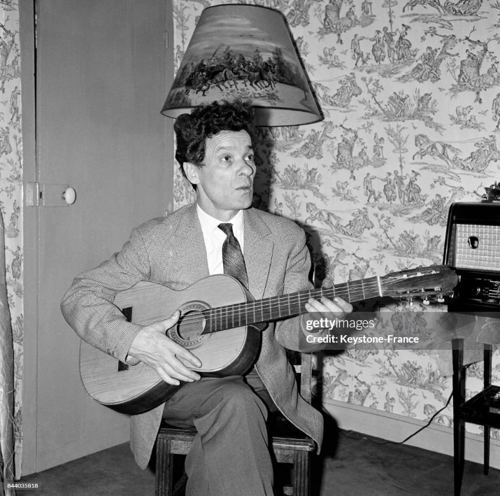
The late turning point
From early efforts to set up organisations of Sinti and Roma survivors in Austria and (West) Germany to attempts at setting up international organisations
Ionel Rotaru: plans for setting up Romanestan, bicolour flag designed for this territory (unclear where); crowned himself as Vaida Voevod III in 1959, supreme leader of the Ursari tribe; issuing of passports, problems with French authorities
Ionel Rotaru’s CMG as inspiration / starting point for International Romani Union (1978)
The first World Romani Congress, held in Orpington, near London, in 1971: 23 representatives from 10 countries; adoption of the Roma flag and of the Roma anthem Gelem Gelem; decision on the use of the word ‘Roma’ instead of ‘Gypsy’ for the different communities
Official recognition by (West) Germany of the Roma Holocaust in 1982, first memorial to the Sinti and Roma murdered in the Holocaust unveiled in Germany (at Buchenwald) only in 1995
Ionel Rotaru, founder of the Communauté Mondiale Gitane (World Gypsy Community, CMG), 1960

Slide 20


Slide 21
Gelem gelem (I’ve travelled)
I’ve travelled, travelled long roads,
And I met happy Roma
Oh Roma, from where have you come,
With tents on happy roads?
Oh Roma, oh fellow Roma
Once I had a great family
The Black Legion murdered them
Now come, all the world’s Roma
For the Romani roads have opened
Now is the time, now rise up Roma,
We will rise high if we act!
Oh Roma, oh fellow Roma

Slide 22
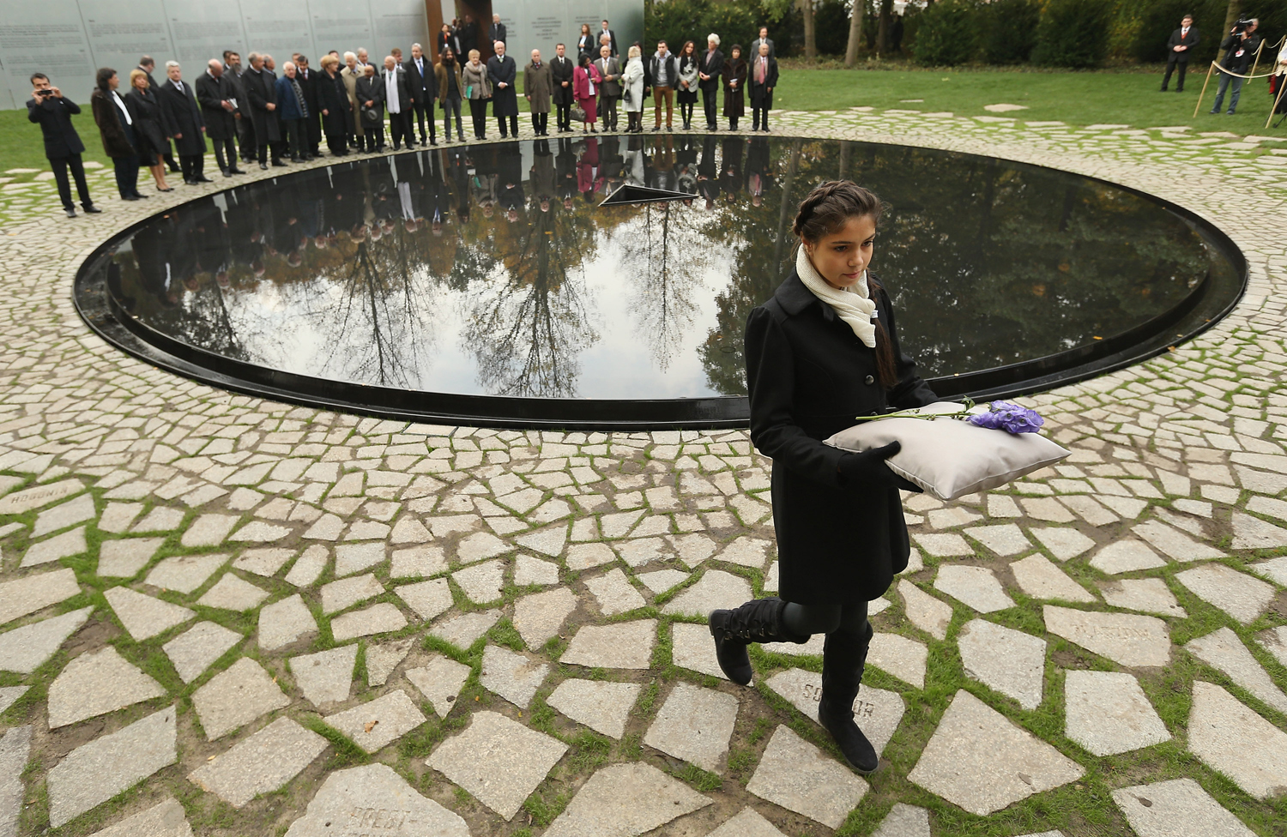
Unveiling of the Memorial to the Sinti and Roma Victims of National Socialism, Berlin (2012)

Slide 23
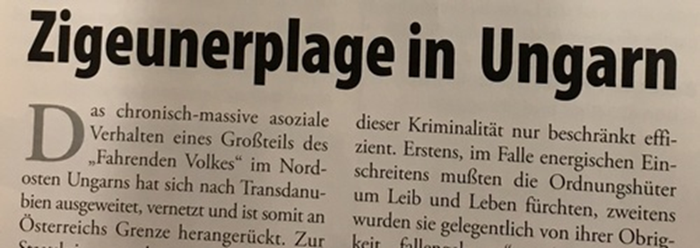
Anti-Roma racism
Roma remain one of the most marginalised and persecuted groups in Europe; racist stereotypes about Roma ‘laziness’ and ‘criminality’ remain, despite (quasi-)recognition of the Roma Holocaust
Romaphobia: The last acceptable form of racism? (Aidan McGarry, 2017)
In 1995, four Roma were killed in a bomb attack in Oberwart, Austria; two of them were the grandsons of Buchenwald and Mauthausen Holocaust survivor Michael Horvath, who in his testimony after the attacks said he had always feared “it would happen again”
During the Covid-19 pandemic: “let’s burn Roma settlements so they do not spread the disease to us” (Ukraine); “until we are able to gas them like the Nazis, the Roma will infect the nation” (Romania)
Article in the right-wing Austrian newspaper Aula, March 2009. Headline reads “Gypsy plague in Hungary”. The excerpt reads: “The chronic and massive anti-social behaviour of a large part of the ‘travelling people’ in northeastern Hungary has spread to the Transdanubian region, where it has taken hold and thus moved closer to the Austrian border.”

Slide 24
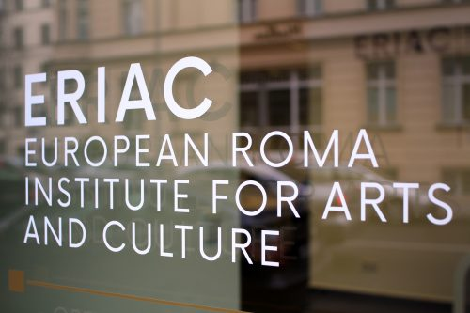
From nation-building to Roma identity through culture
Ionel Rotaru’s early efforts to get international recognition for Roma cultural assets, from language to music and fine arts
Support of Roma institutions (e.g., International Romani Union) by international organisations (especially the Council of Europe, later also European Union), establishment of the European Roma and Travellers Forum in 2004
Decade of Roma Inclusion (2005-2015): 12 European countries committing to close the gap (educational, economic, etc.) between Roma and majorities in those states; anti-racism
European Roma Institute for Arts and Culture, joint initiative of the Council of Europe, the Open Society Foundations, and the Alliance for the European Roma Institute for Arts and Culture (2017): not just combatting prejudice, but promoting the self-esteem of Roma across Europe
Roma Foundation for Europe (2023)

Slide 25
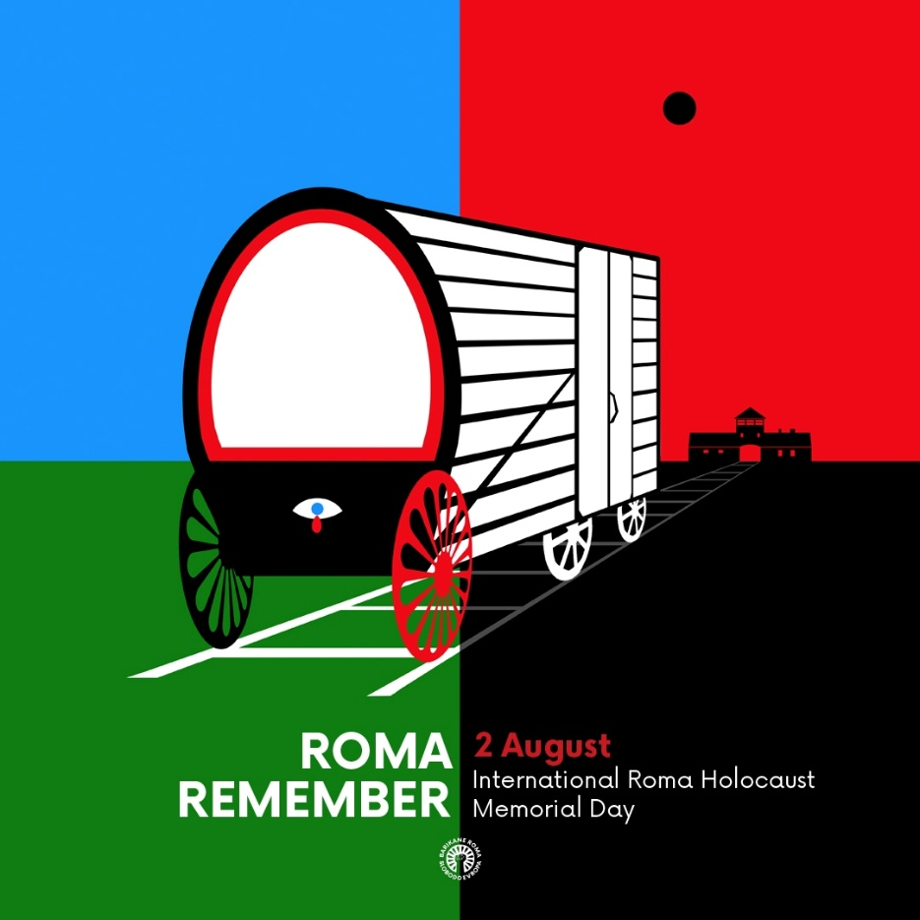
Momentum for recognition
Self-representation, instead of ascription of identity (as “Gypsy”) by others
More recognition for Roma identity, but still not universally accepted among all Roma communities in Europe: flag, anthem; e.g., Sinti and Roma in Germany
2 August (the day when the ‘Zigeunerlager’ – “Gypsy camp” – in Auschwitz was liquidated) was declared International Roma Holocaust Memorial Day by the European Parliament in 2015
Increasing visibility over the last decade
Importance of history for the formation and promotion of Roma identity

Slide 26
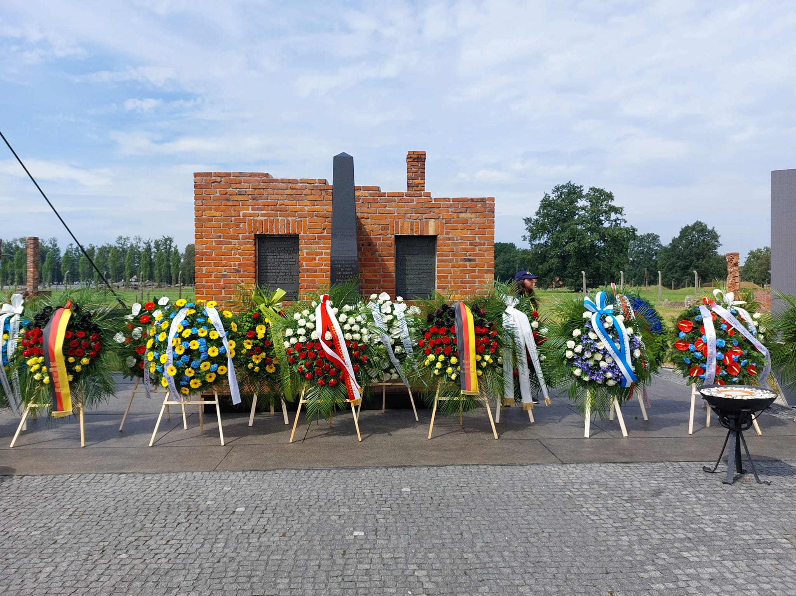
Unveiling of the Memorial to the Sinti and Roma Victims of National Socialism, Berlin (2012)

