Slide 1
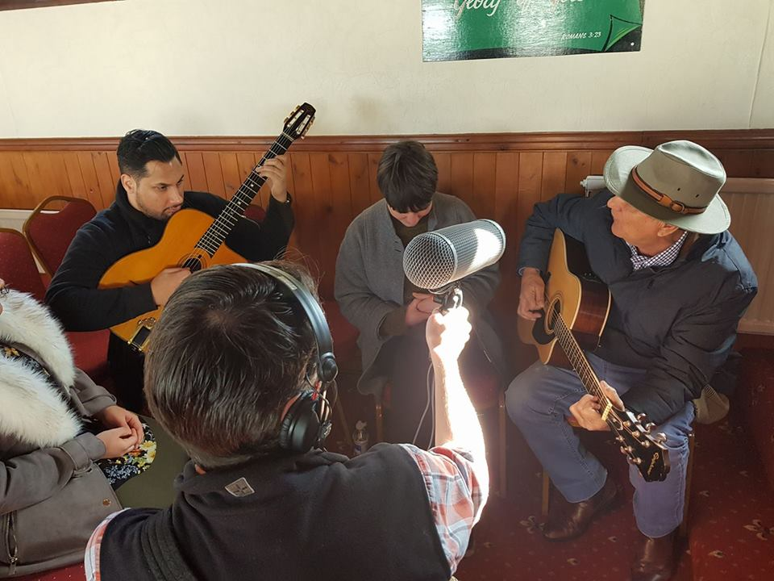
Roma voices in the mainstream media : challenges, opportunities and past experiences
Jake Bowers, Romani Journalist and Broadcaster

Slide 2
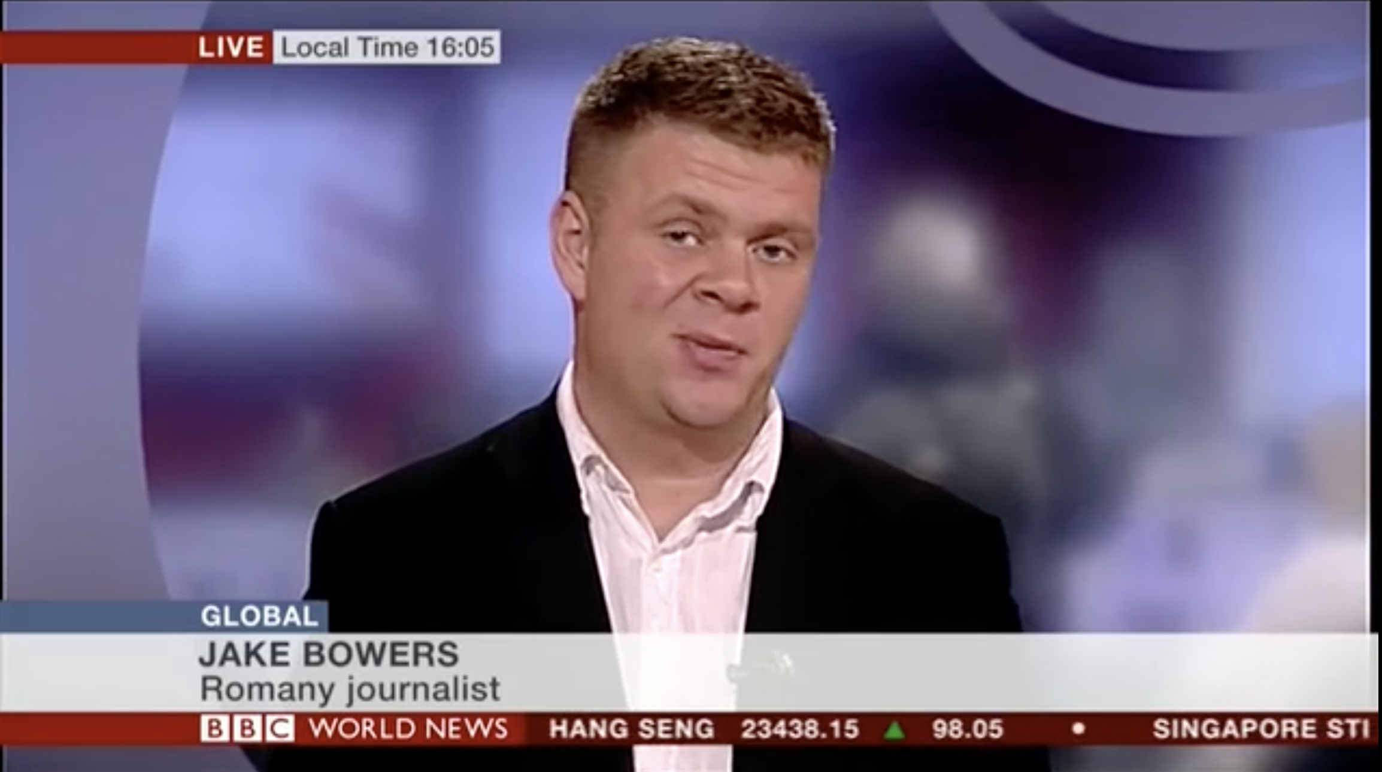
Who am I?
One of Britain’s very few Romani journalists and film makers
BBC Radio and TV
ITV / Channel 4
Sony Music
Warner Brothers
Advertising
www.jakebowers.co.uk

Slide 3
Threats: If it bleeds, it leads….
Reporting of Roma communities draws upon and perpetuates racist stereotypes
Foreign Dirty
Criminal Nomadic
Lazy Psychic
Wanderlust Take
Steal children Stupid
It often constructs rather than reflects reality
BUT understanding that fictional and fact-based TV is driven by conflict and the need for resolution can also provide opportunities

Slide 5
Must become opportunities….for us!

Slide 6
How can we strengthen Romani voices in mainstream media? How can we ensure more self-representation in the media?
By encouraging story telling in all its forms as a worthy career goal
We desperately need more Romani journalists, directors, producers, cinematographers, animators etc that are well- trained
Talent is nothing without opportunity, we must help each other
We must act collectively to exclude those with inherently negative agendas from our communities
There is a direct link between representation in front of the camera and the power behind the camera. We will only get good representation when we have editorial power. Nothing about us, without us
By using community media to incubate talent in order for it then to impact mainstream media
By demanding that public service broadcasters serve their Romani communities properly
By being opportunistic and populist, daring to take risks and using the gadjo fascination as a way in
By using every platform, traditional and emerging to tell our stories
By working across all areas of diversity and being more than an adjective
By learning from other successful struggles for better representation

Slide 7
If you can’t beat them, join them:
8-hour series on Sky TV that led to proud community members smashing X Factor

Slide 8
If you can’t beat them, join them:
BBC Rokker Radio - only community radio programme for the Romani and Traveller community led to improved coverage of Romani issues across BBC output

Slide 9
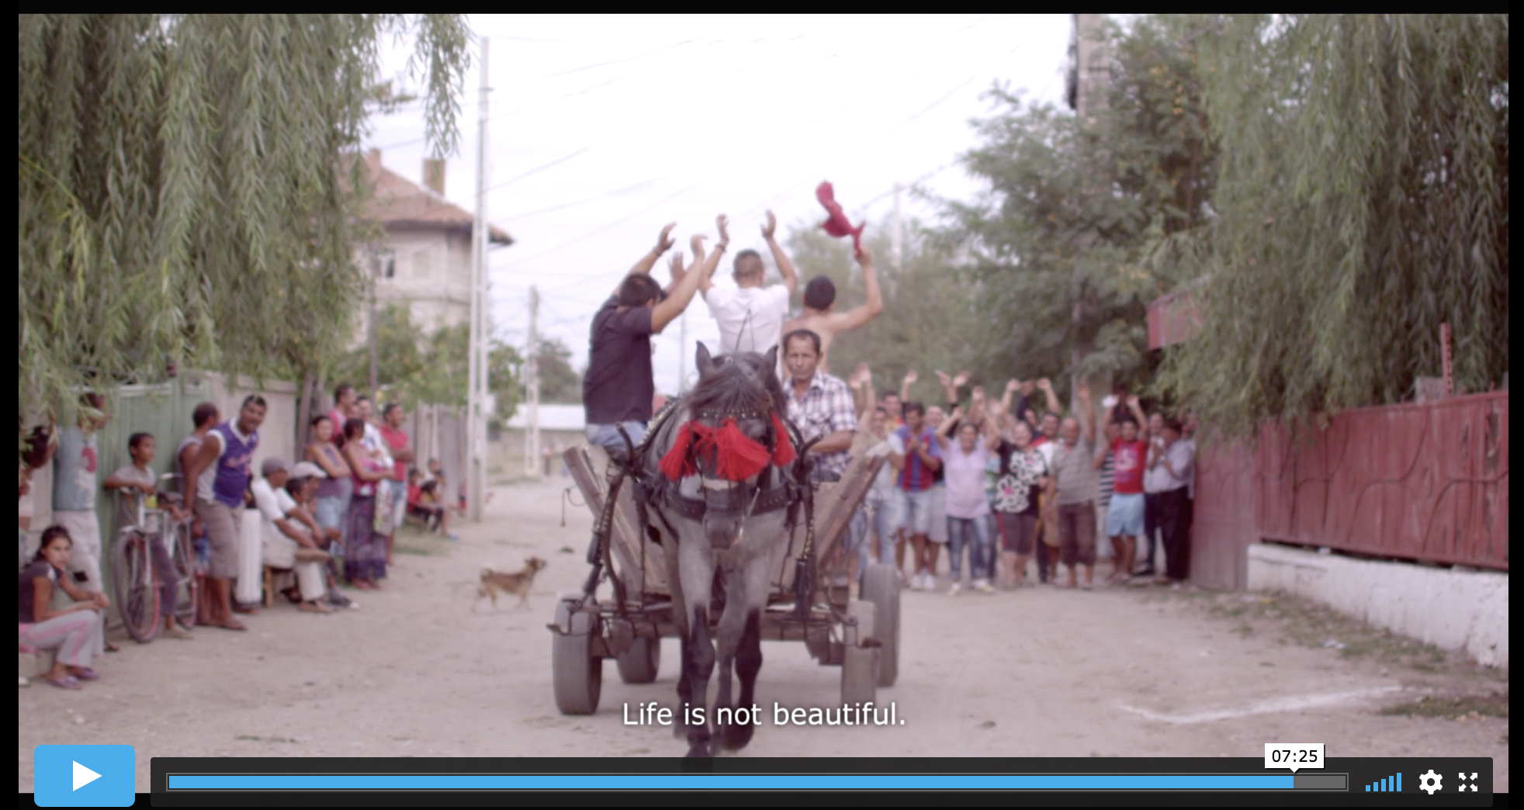
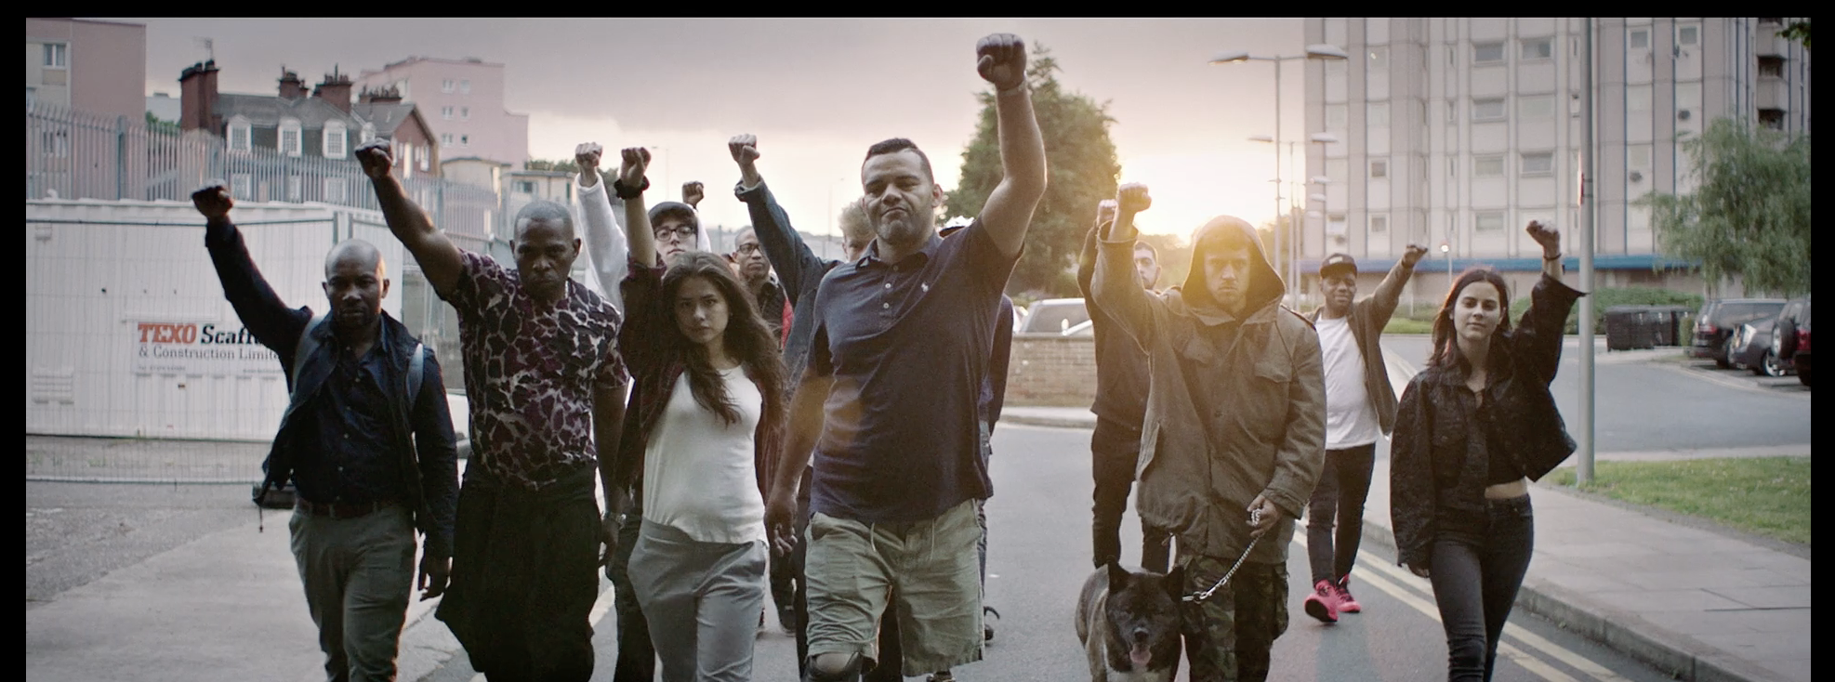

Slide 10
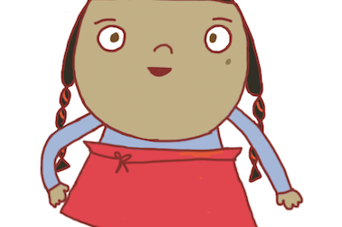
60 Days with the Gypsies – Channel 4 First series with Romany producer
Romani Children in State Care Campaign
Dora the Explorer / Black Panther

